Slide 1
Reducing Annotation Effort on Unbalanced Corpus based on Cost Matrix
Wencan Luo¹, Diane Litman^{1,2} and Joel Chan²
¹Department of Computer Science
²Learning Research and Development Center
University of Pittsburgh
Pittsburgh, PA USA
Notes:
Today. I’m going to show you a method to reduce annotation effort on unbalanced corpus based on cost matrix.

Slide 2
Outline
Introduction
Proposed annotation scheme
Extrinsic evaluation
Summary and future work
Notes:
Just

Slide 3
Motivation
High-quality annotated corpora are desirable.
Annotation is tedious and costly.
It’s a tradeoff between data quality and human effort.
Reducing annotation effort but not hurting the quality?
Notes:
Desirable [dɪ'zaɪərəbl]

Slide 4
Highly Skewed Distribution
A significant proportion of corpora are unbalanced (unbalanced degree: 3% ~ 24%)
text classification (Forman, 2003)
information extraction (Hoffmann et al., 2011)
emotion detection (Ang et al., 2002; Alm et al., 2005)
sentiment classification (Li et al., 2012)
polarity of opinion (Carvalho et al., 2011)
uncertainty and correctness of student answers in tutoring dialogue systems (Forbes-Riley and Litman, 2011; Dzikovska et al., 2012),
Notes:
the distribution of class categories are heavily skewed towards one or a few categories
Can we make things easier on such corpus?

Slide 5
Related Work: Reducing Annotation Effort
Semi-supervised learning methods
active learning (Cohn et al., 1994; Zhu and Hovy, 2007; Zhu et al., 2010)
co-training (Blum and Mitchell, 1998)
self-training (Mihalcea, 2004)
Supervised methods + manual checking
pre-annotation (Brants and Plaehn, 2000; Chiou et al., 2001; Xue et al., 2002; Ganchev et al., 2007; Chou et al., 2006; Rehbein et al., 2012)
Notes:
What’s the difference between Semi-supervised learning and supervised learning?
Semi-supervised learning: make use of both labeled and unlabeled data
Active learning reduces annotation by carefully selecting more useful samples.
Co-training relies on several conditional independent classifiers to tag new unlabeled data
self-training takes the advantage of full unlabeled data.

Slide 6
Proposed Annotation Scheme for Unbalanced Corpus
Belongs to pre-annotation
Annotation Steps:
build a high-recall classifier
apply to the rest of the unlabeled data
manually check every positive label
Challenges
how to get a high-recall classifier
concern of the overall quality of data

Slide 7
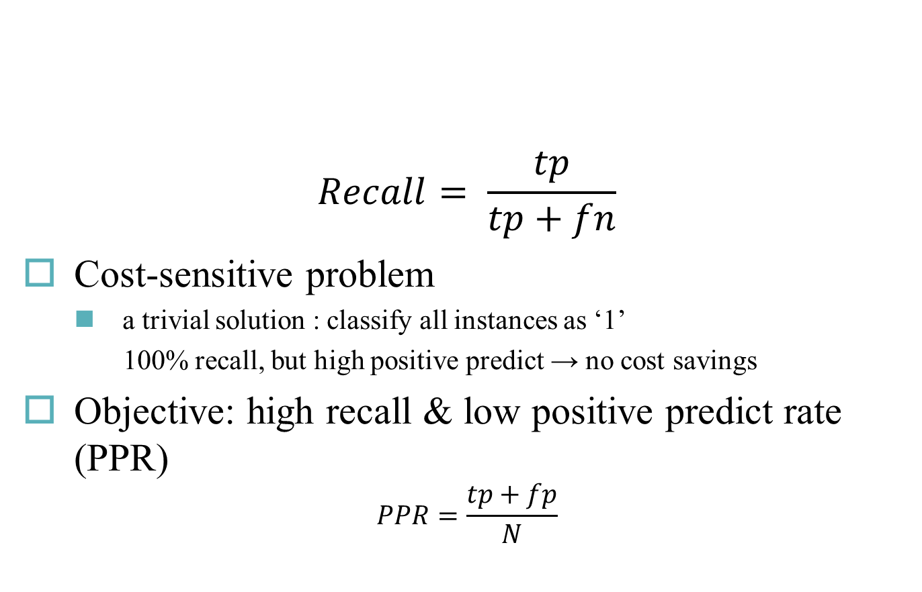
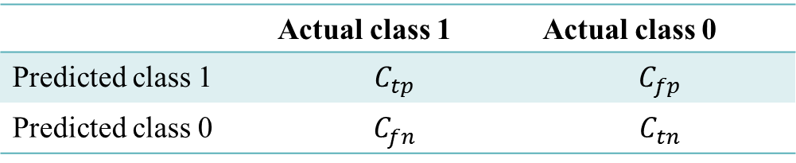


High-Recall Classifier: Cost Matrix
$$Recall= \frac{tp}{tp+fn}$$
Cost-sensitive problem
a trivial solution : classify all instances as ‘1’
100% recall, but high positive predict → no cost savings
Objective: high recall & low positive predict rate (PPR)
$$PPR=\frac{tp+fp}{N}$$
 | Actual class 1 | Actual class 0
Predicted class 1 | $$C_{tp}$$ | $$C_{fp}$$
Predicted class 0 | $$C_{fn}$$ | $$C_{tn}$$
$$↑$$
$$\text{↓}$$
Notes:
We want to minimize the fn
Turn this task into a cost-sensitive task

Slide 8
Experiment
Annotation for presence/absence of uncertainty
Corpus
transcribed human-human dialogues
annotated by two coders (kappa = 0.75)
Speaker | Utterance | Uncertainty?
S6 | You can't see the forest through the trees. | No
S1 | I'm not quite sure | Yes
 | # of Utterances | Unbalanced Degree
Train | 12,331 | 13.3%
Test | 1,558 | 14.2%
Unlabeled | 42,641 | ?

Slide 9
Basic Classifier
Feature Set
133 Keywords/Phases
Results on test set
using SVM
recall: 67.4%
PPR: 10.9%
Notes:
Why not use n-gram?

Slide 10
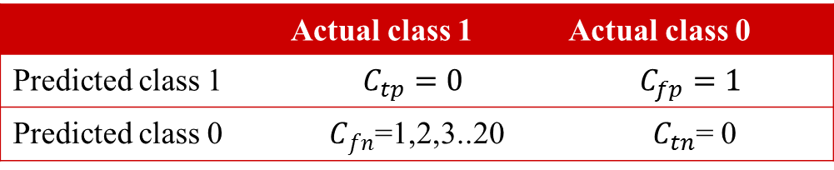

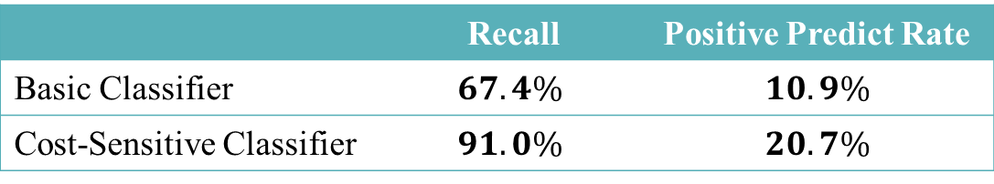
High-recall Classifier
Cost Matrix
Result on Test Set (SVM is the best)
Up to 80% annotation effort reduction
$C_{fn}=15 \left(chosen based on train set\right)$
 | Actual class 1 | Actual class 0
Predicted class 1 | $$C_{tp}=0$$ | $$C_{fp}=1$$
Predicted class 0 | $C_{fn}$=1,2,3..20 | $C_{tn}$= 0
 | Recall | Positive Predict Rate
Basic Classifier | $$67.4\%$$ | $$10.9\%$$
Cost-Sensitive Classifier | $$91.0\%$$ | $$20.7\%$$

Slide 11
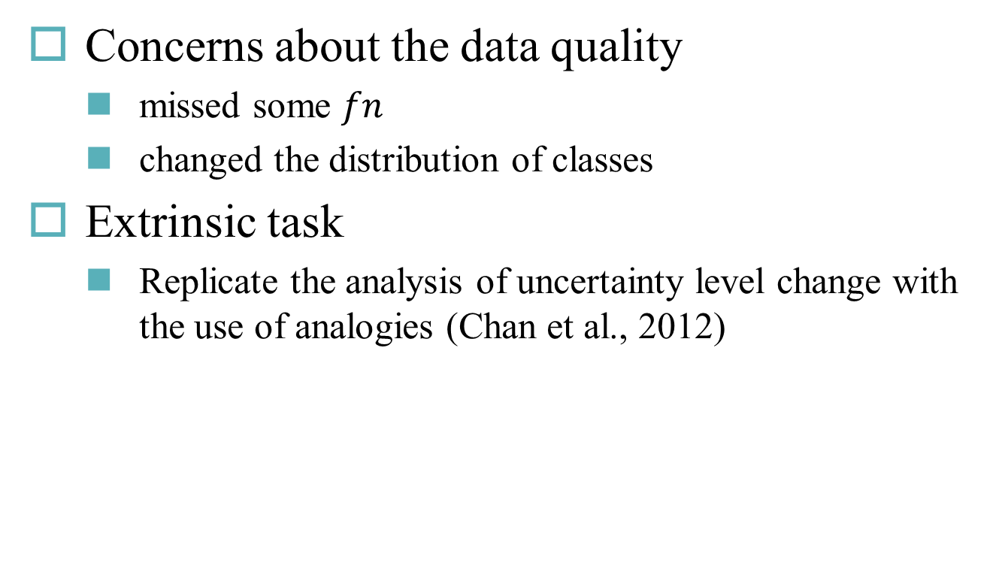
Extrinsic Evaluation
Concerns about the data quality
missed some $fn$
changed the distribution of classes
Extrinsic task
Replicate the analysis of uncertainty level change with the use of analogies (Chan et al., 2012)
Notes:
Analogy: a cognitive strategy where a source and target knowledge structure are compared in terms of structural correspondences as a strategy for solving problems under uncertainty
Joel Chan, Susannah B. F. Paletz and Christian D. Schunn. 2012. Analogy as a strategy for supporting complex problem solving under uncertainty. Memory & Cognition, 40, 1352-1365.

Slide 12
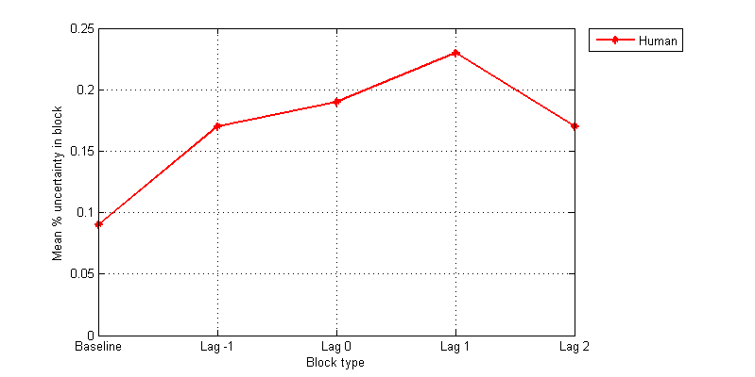
Extrinsic Evaluation Result
Under two conditions
manual label
predicted label and manually check
NOT substantially alter or miss known statistical effects
Notes:
human golden standard

Slide 13
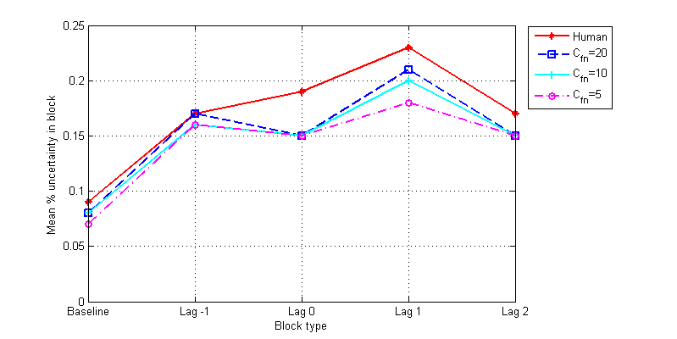
Extrinsic Evaluation Result
Under two conditions
manual label
predicted label and manually check
NOT substantially alter or miss known statistical effects
Notes:
all the lines with the cost matrices and say that the pattern/prior findings are mostly same.

Slide 14
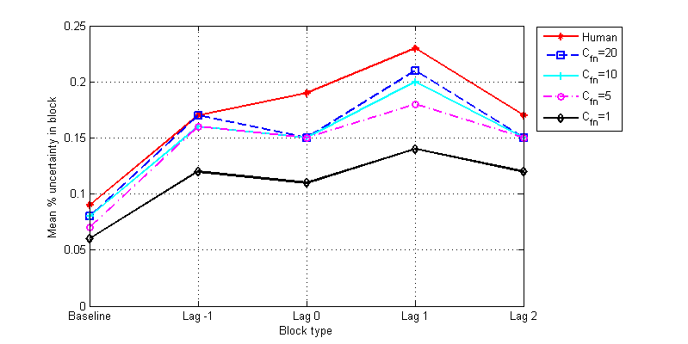
Extrinsic Evaluation Result
Under two conditions
manual label
predicted label and manually check
NOT substantially alter or miss known statistical effects
Notes:
without the high recall approach, the automatic annotations are no longer useful.

Slide 15
Summary
An annotation scheme based on cost matrix
lowers the threshold to build a high-recall classifier
reduces significant annotation effort (by checking only the positive predictions)
does not sacrifice data quality
Future work
experiment with different tasks
extend to multi-class classification tasks
explore effects of the degree of unbalance

Slide 16
Thank you!
Questions?

Slide 18
Key Words/Phrases
‘+’ : some evidence of uncertainty
‘-’ : no evidence of uncertainty
‘*’ : may or may not show uncertainty
‘1’ : from (Hiraishi et al., 2000)
‘2’ : from (Holms, 1999)

Slide 19
Key Words/Phrases Cont.

Slide 20
Basic Classifier
Feature Set
133 Keywords/Phases
Results

Slide 21
High-recall Classifier
Costs
Result on Test Set (SVM is the best)
Up to 80% annotation effort reduction
 | Actual class 1 | Actual class 0
Predicted class 1 | $$C_{tp}=0$$ | $$C_{fp}=1$$
Predicted class 0 | $C_{fn}$=1,2,3..20 | $C_{tn}$= 0

Slide 22
Analogy
Definition:
Analogy is a fundamental cognitive process in which a source (a known piece of information) and a target (a problem or current domain of knowledge) are linked to one another by a systematic mapping of attributes and/or relations, which then allows for transfer of existing knowledge to the target (Gentner, 1983; Holyoak & Thagard, 1996b).
Example:
the solar system and an atom
both having a nucleus and orbiting elements.
Notes:
atom ['ætəm]
Solar ['soʊlər]

Slide 23
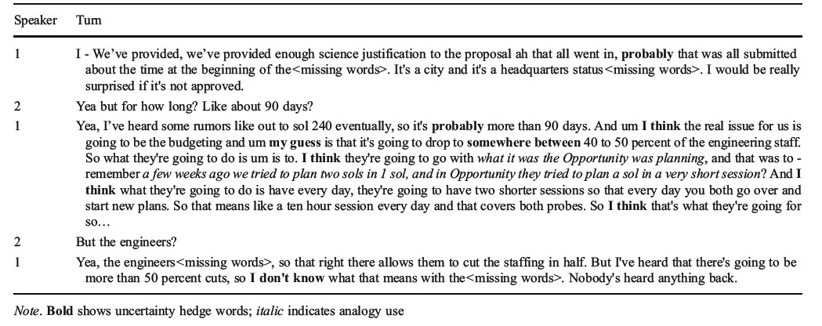
Analogy Example
Analogy Block
Others
10 utterances before
Analogy
10 after
10 more after
Baseline
Lag -1
Lag 0
Lag 1
Lag 2

Slide 24
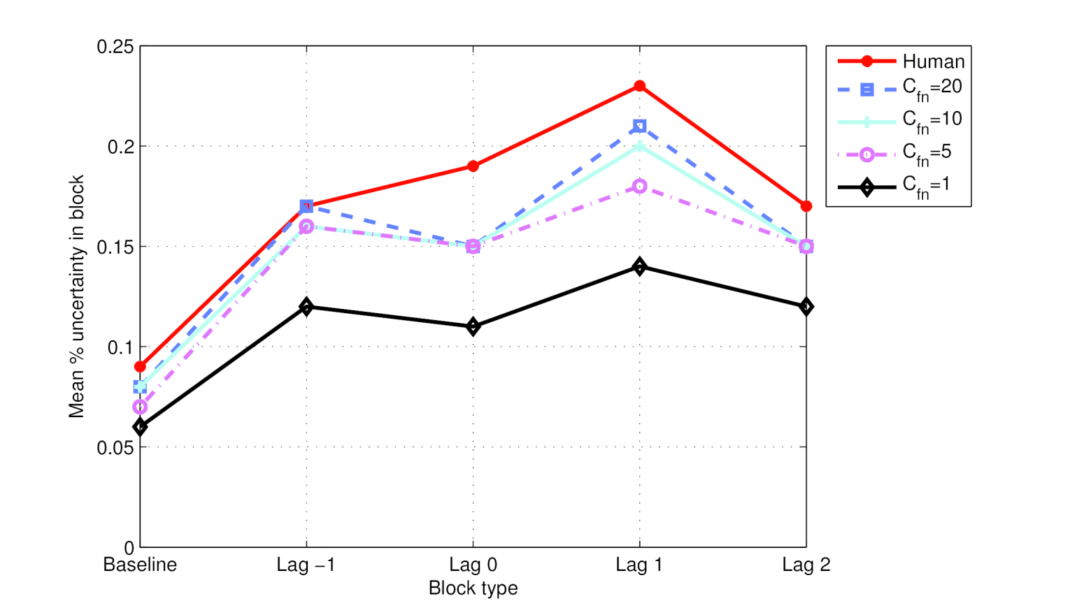
Extrinsic Evaluation Result
the recall rate of the classifier is sufficient to not substantially alter or miss known statistical effects.

Slide 25
Significant Test
Standardized mean difference from baseline
(‘*’ denotes p < .05, ‘**’ denotes p < .01)
Notes:
Why C-Fn = 20 with Lag 2 is not significant?
the standardized mean difference remains very similar)

